Slide 1



Digital Marketing Strategy
Handlooms of Ancient Odisha
by Dibyajyoti swain

Slide 2

Overview
Current Status
Target Audience
Marketing Objectives-Roadmap
Strategy
SEO
On Page
Off Page
Google Ads
Social Media

Slide 3
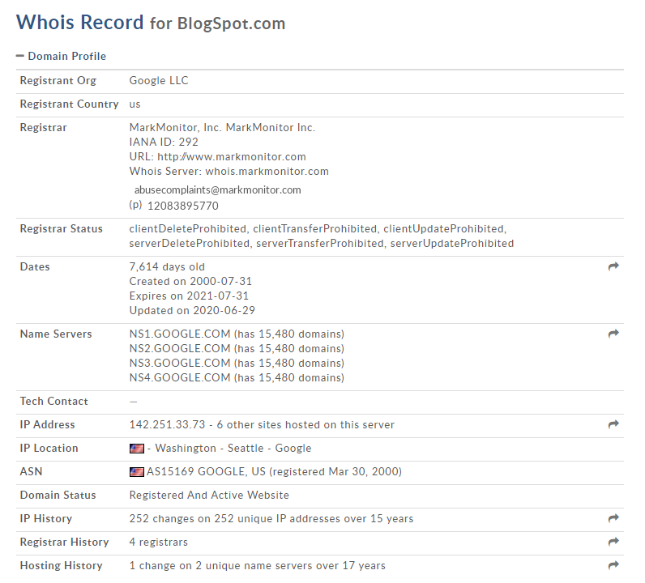
Current Status
History of my Domain
Details of my domain gathered from Whois Lookup web. Blogspot.com is genuine and certified domain provider for my blog.

Slide 4
Current Status-Basic Setup
Description: The Handloom business of the Indian nation is one among the foremost lovely and expert sectors. However, with the appearance of power looms and artificial textiles this business has been troubled. With the present crisis of the COVID-19 pandemic and different natural disasters, the business has got to take another blow. As people, we tend to do too to preserve the bread and butter alongside the traditional techniques and art forms that have passed down generations for many years.
Tittle: Handlooms of Ancient Odisha
Keyword's presence: Handlooms of Odisha, blogs on textiles, Odisha weavers blog, sarees of Odisha, Odisha textiles, Orissa handlooms.
Website URL: https://ancient-odisha-handlooms.blogspot.com/

Slide 5
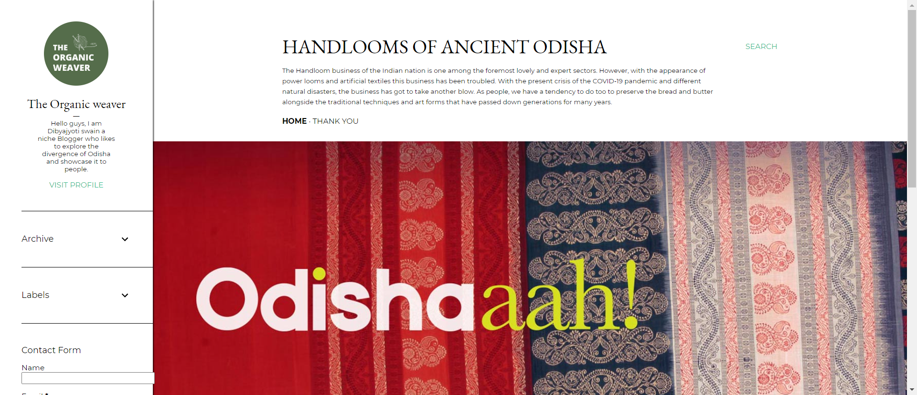
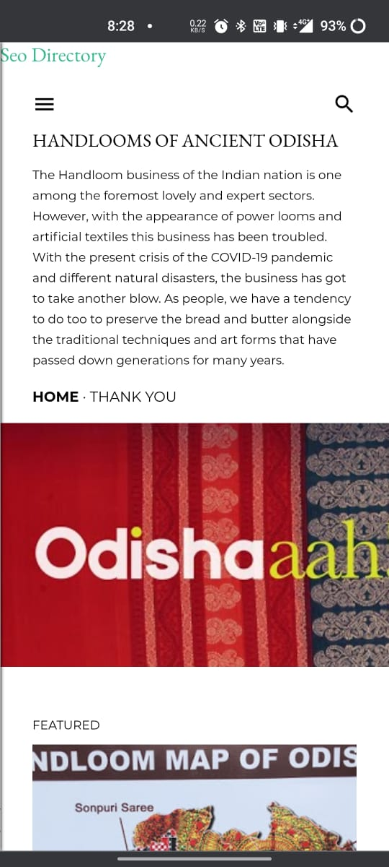
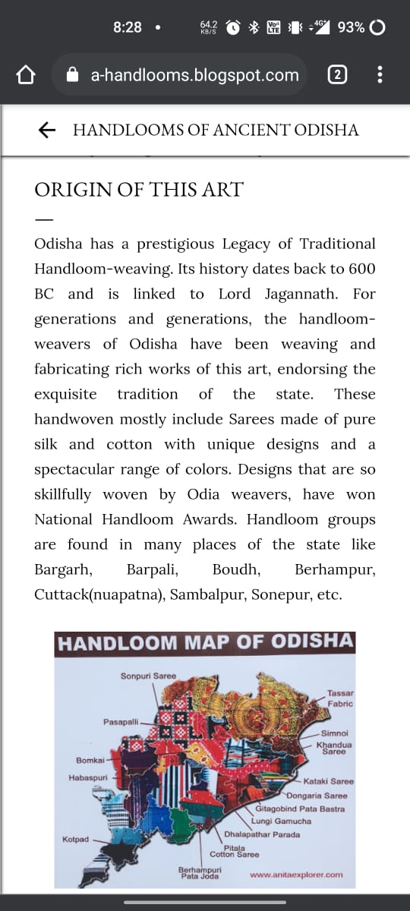
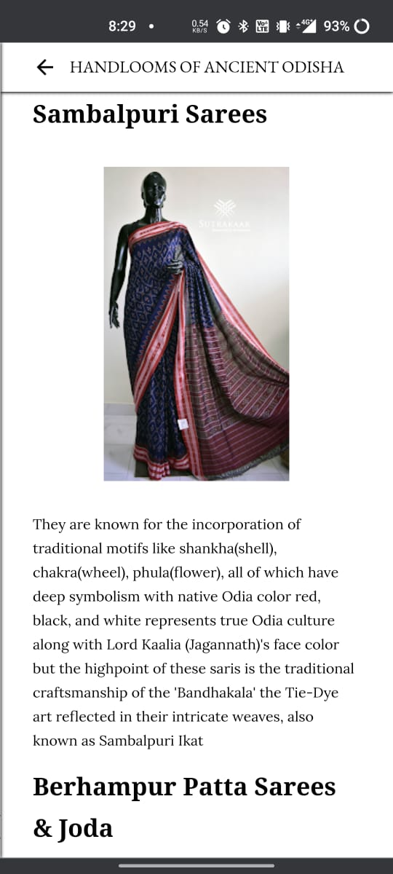
Website View

Slide 6
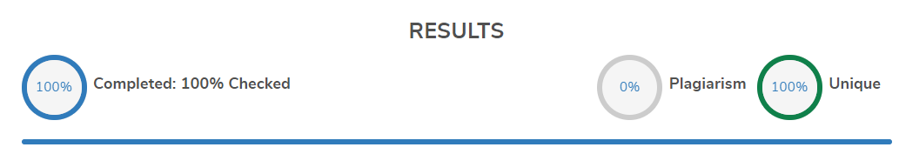
Current status
Plagiarism Checkup
The contents of my blog was free of any kind of plagiarism and grammatical mistakes.

Slide 7
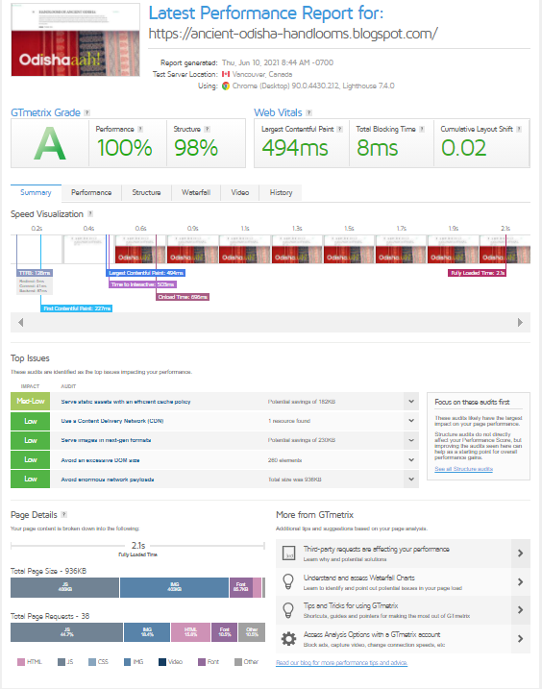
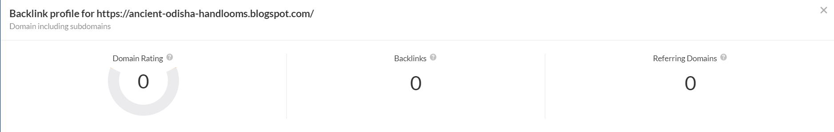
Webpage Insights
Page load time is well under appreciable Time(2.1sec) for best user interaction.(via GTmetrix)
Currently my blog doesn't have any backlinks.

Slide 8
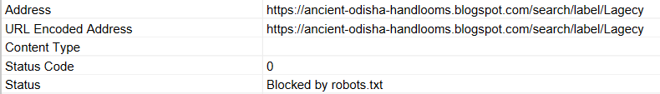
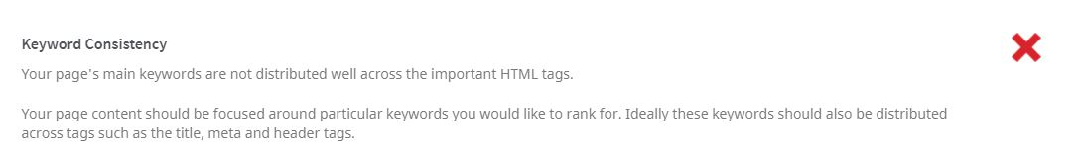
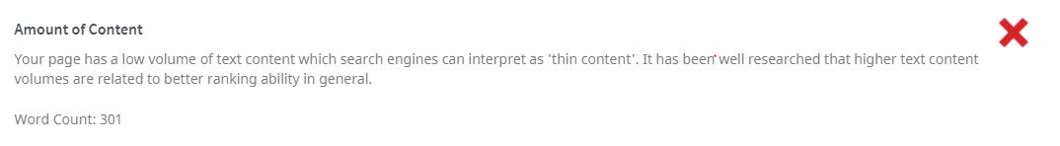
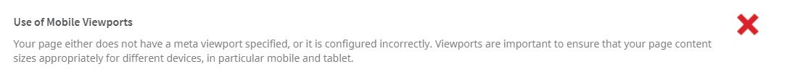
On-Page SEO

Slide 9

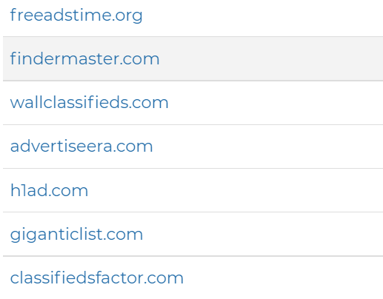
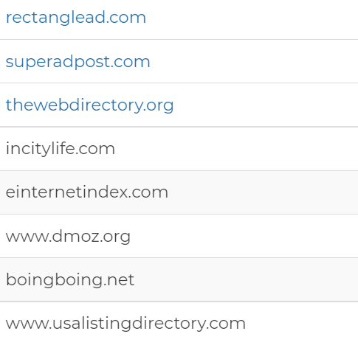
Off-Page SEO
So far submitted in
but also looking forward to submit in

Slide 10
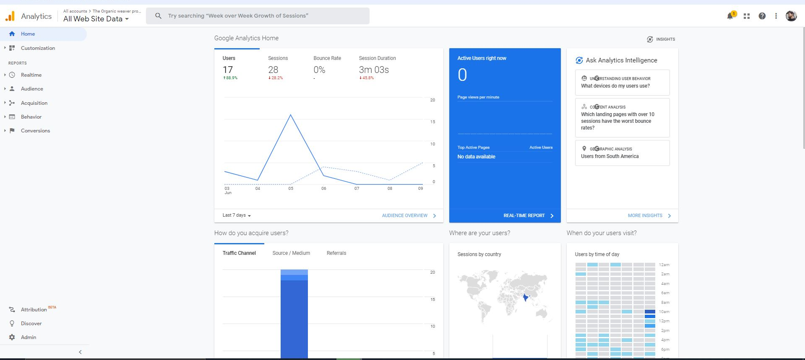
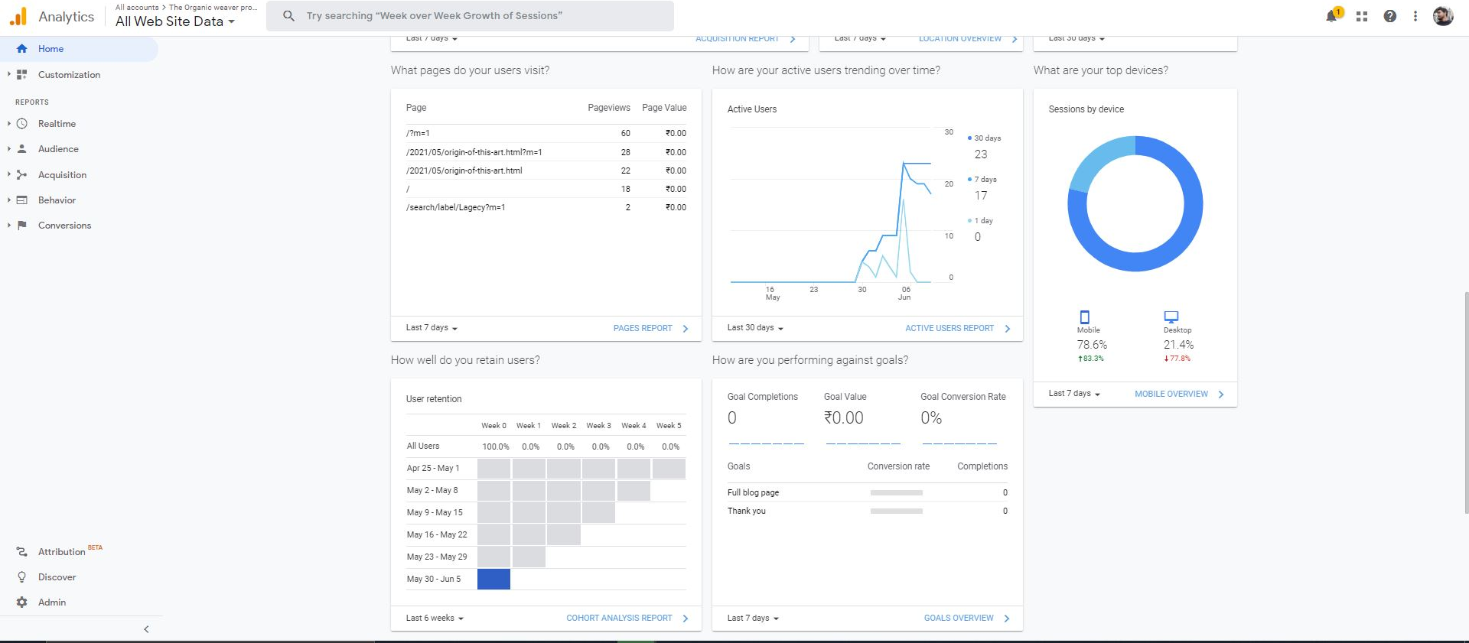
Integrations: Google Analytics

Slide 11
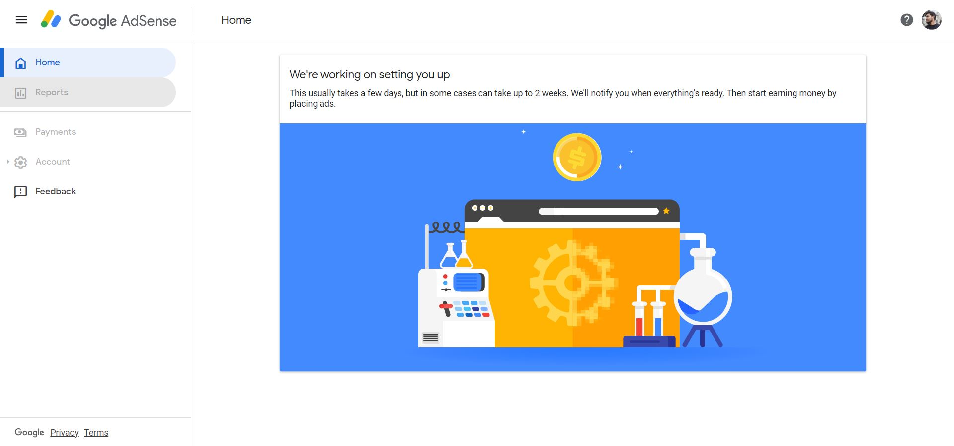
Google Adsence

Slide 12
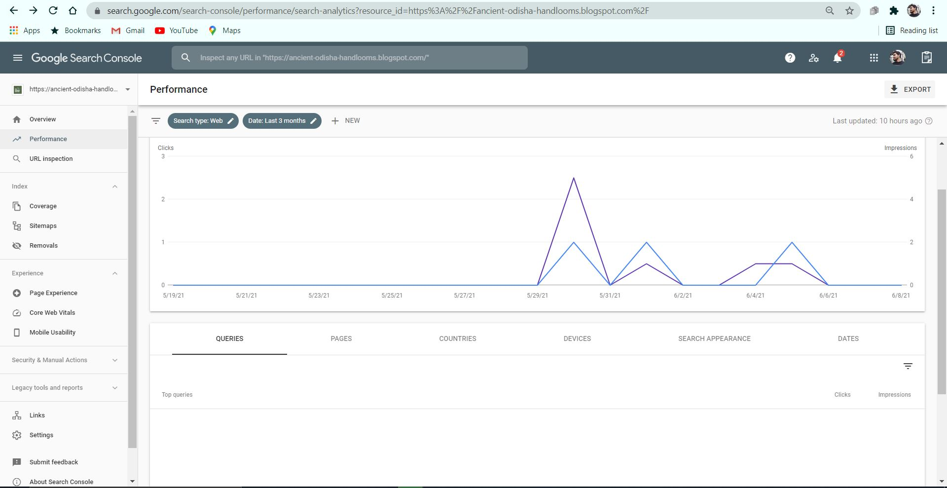
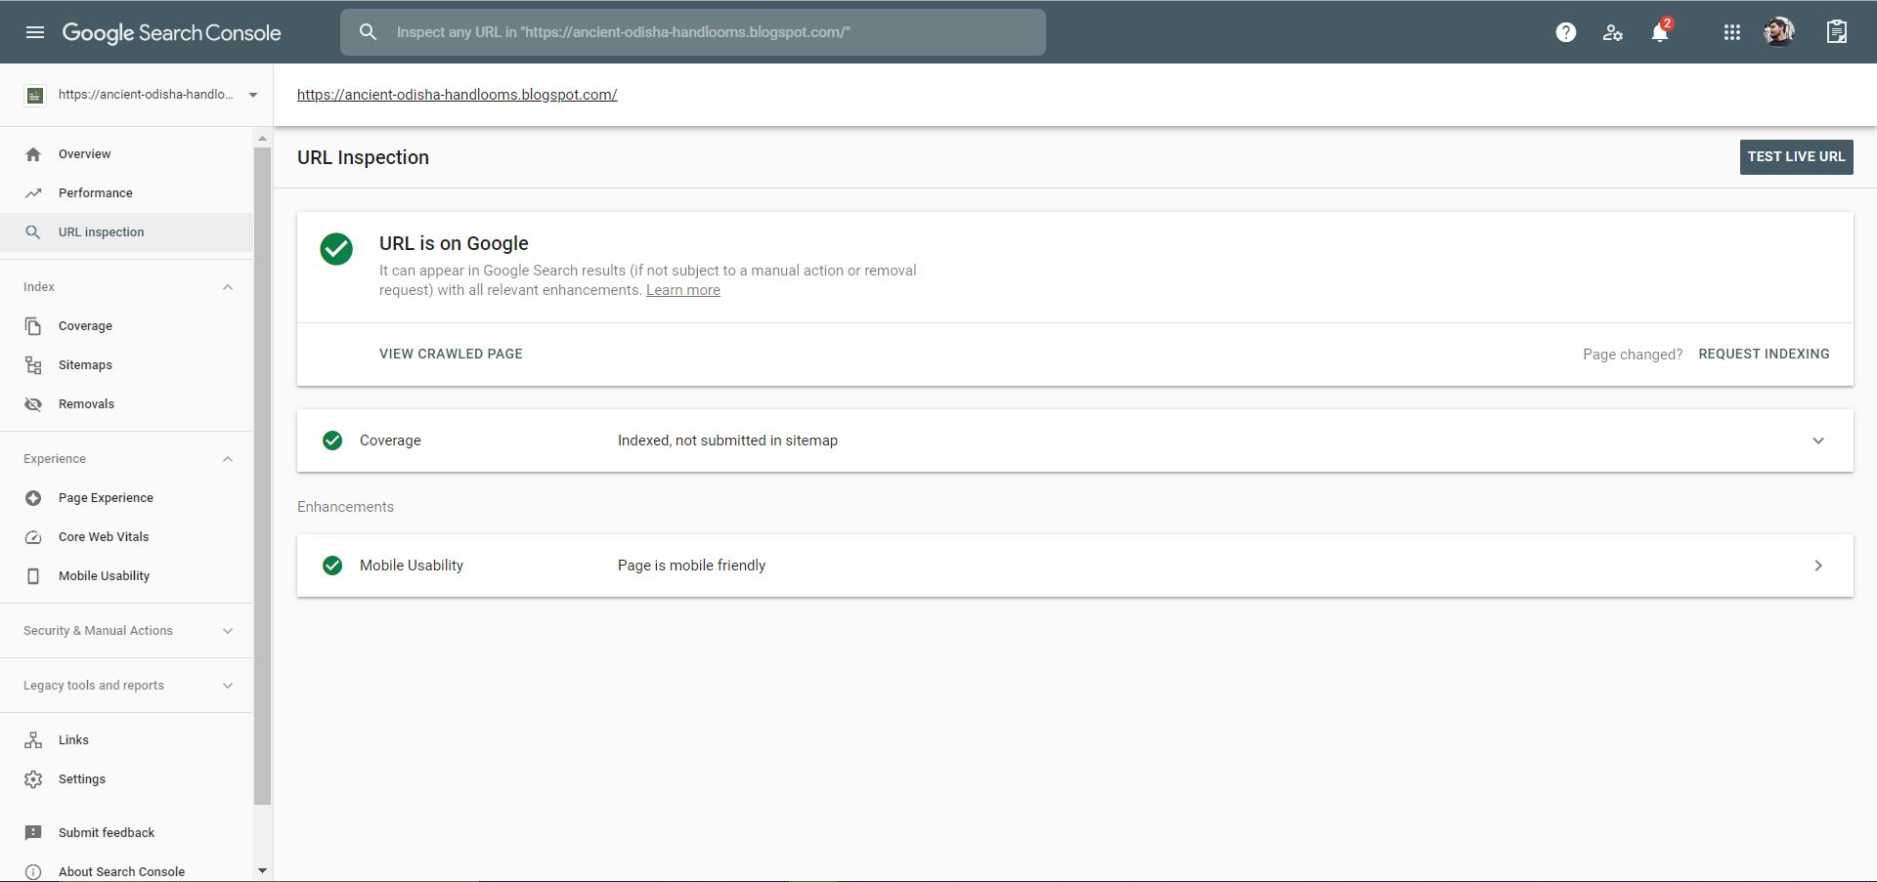
Google Search Console

Slide 13
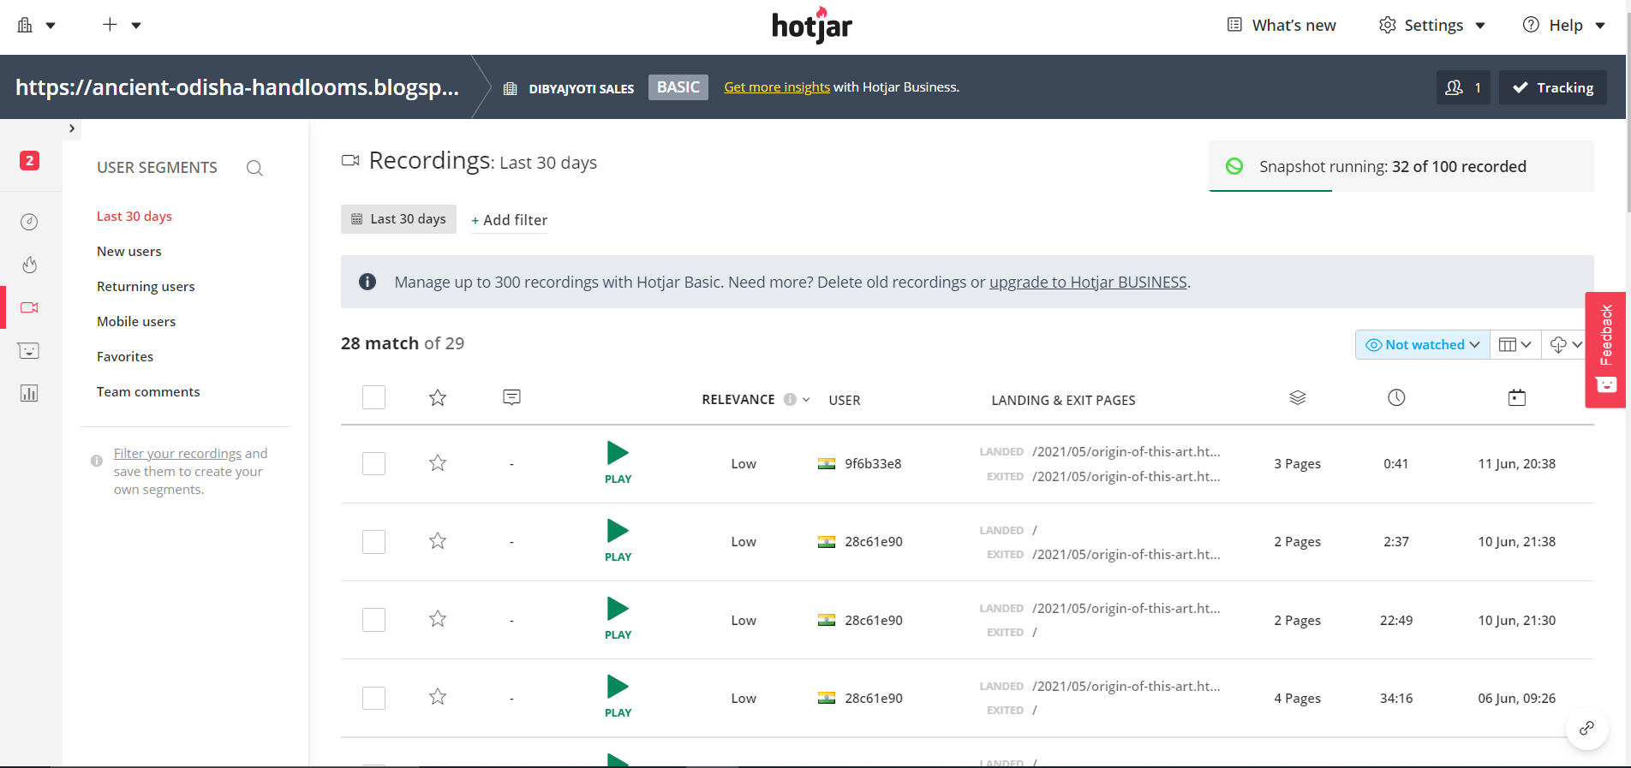
Hotjar

Slide 14
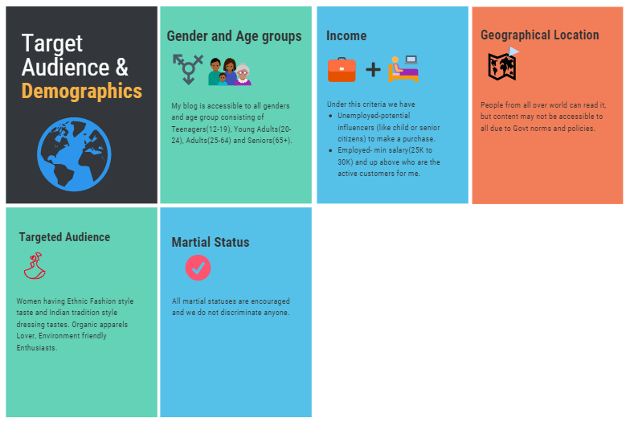

Target Audience

Slide 15
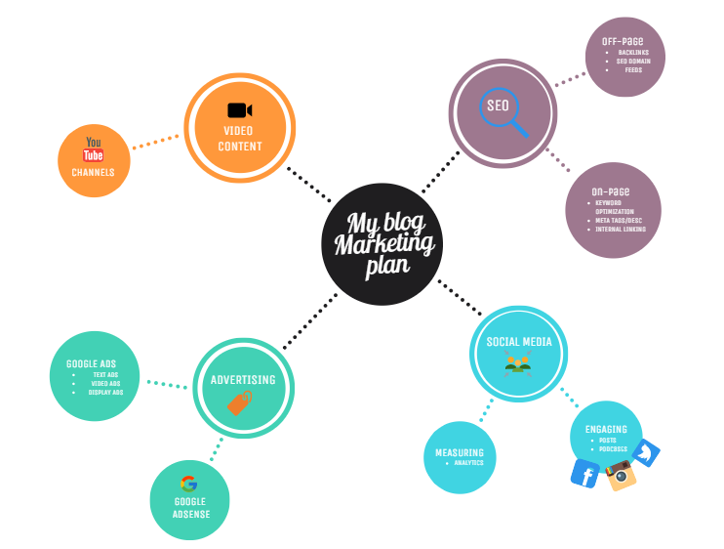
Marketing odjectives
This roadmap shows the objectives that I must complete in order to create my brand awareness and inform users about the service that I as content writer am providing.

Slide 16
Strategy Content
Web Content
Review existing content for keyword presence
Increase the number of keyword used to increase the rank in Google search results.
Ask for recommendations regarding the blog.
Blog Content
Explore new themes and content to write blog posts on.
Increase the frequency of blog posts to 2 per week.
Create more enlightening content for the blog.
Cover variety of topics.

Slide 17
Google Ads
Search Campaigns
Text Ads
Display Campaigns
Image Ads
Video Campaigns
Video Ads
Screenshot of Keywords

Slide 18
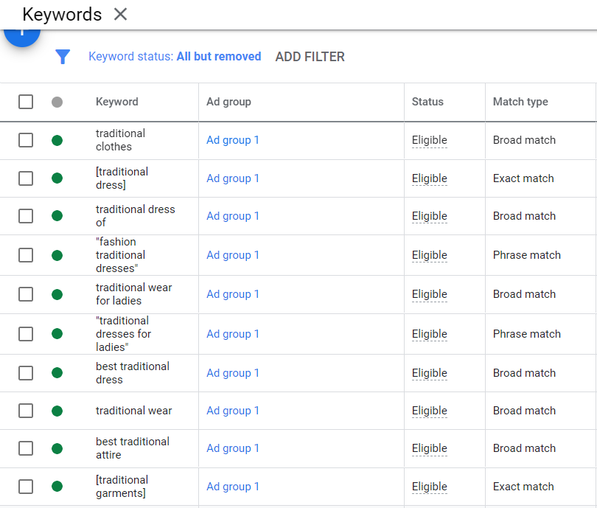
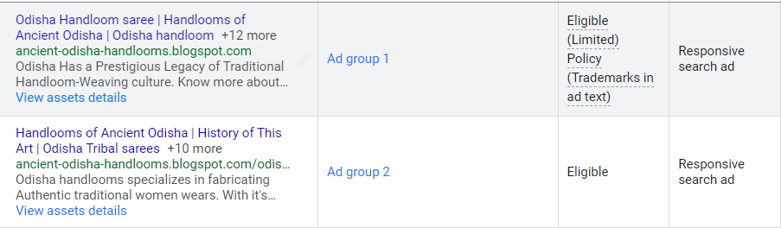
TEXT ADS

Slide 19
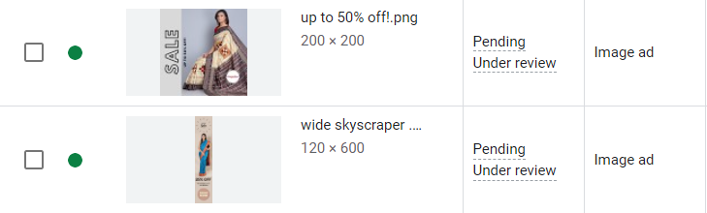




DISPLAY ADS

Slide 20
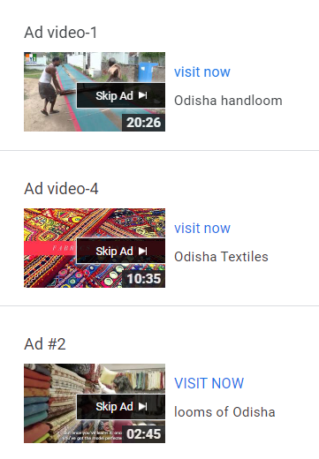
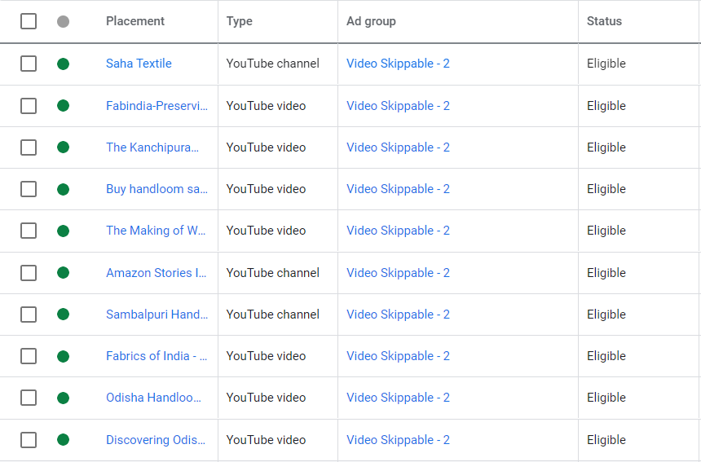
VIDEO ADS

Slide 21
Social Media
Facebook
Instagram
YouTube
Facebook Page
Instagram Account
YouTube Channel

Slide 22
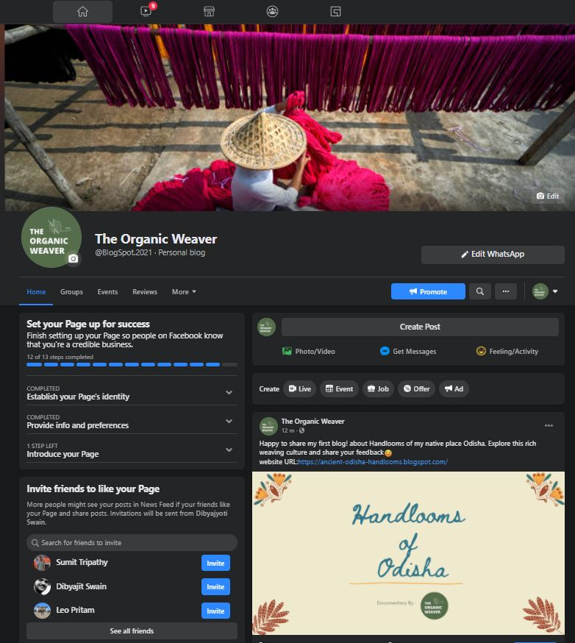
Facebook
There is currently 0 followers in our page, but we are targeting a minimum 500 followers by the end of August.
We want to post more photos and videos for the people about our content.
We also wants to conduct Facebook lives regularly as per content calendar.

Slide 23
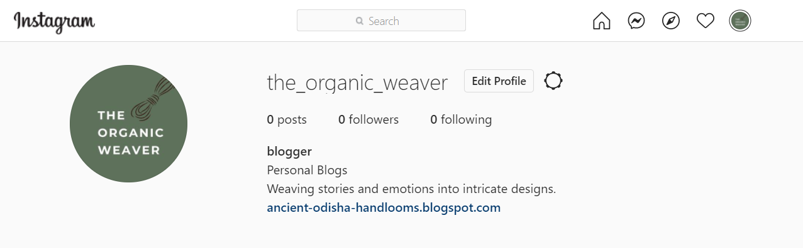
Instagram
Our Instagram page currently have 0 followers. But we are targeting to have 500 followers by the end of August.
We have planned to posts content regularly as per the content calendar. Also planning to conduct regularly live sessions and keep answering the queries of our followers.

Slide 24
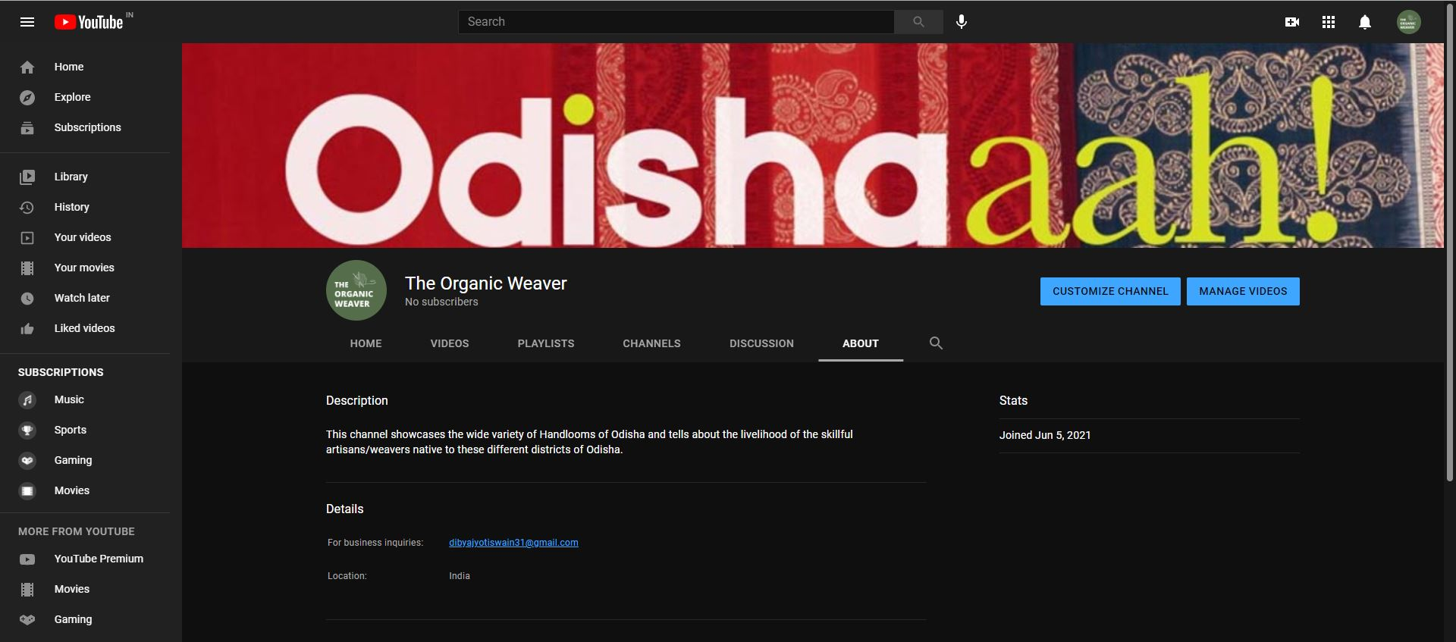
YouTube
Our YouTube Channel currently have zero subscribers but targeting to have 300 subscribers by the end of this year.
We plan on posting videos according to our content calendar.

Slide 25
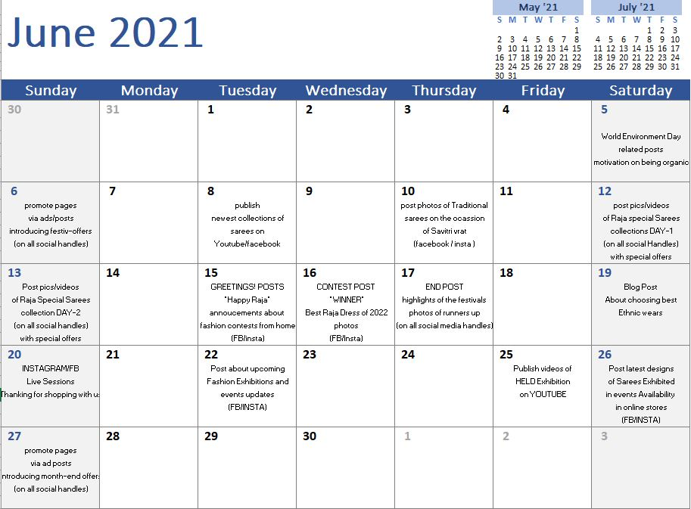

Social Media Content Calendar

Slide 26


THANK YOU!

